Slide 1
Cholelithiasis
Student’s Name
Institutional Affiliation
Date

Slide 2
Introduction
This presentation will be about Cholelithiasis which is one of the most common illnesses in gastroenterology (Almarzooqi et al., 2018).
it refers to the occurrence of gallstones, masses that form in the biliary tract, mainly in the gallbladder.
The treatments offered usually depends on the stage of the illness.
Gallstones range in sizes which can be from the size of a grain to that of a golf ball.
They mainly cause signs and symptoms if they are critical which would need one to undergo a gallbladder removal surgery but those that do not cause any signs require no treatment.

Slide 3
What are the Risk Factors?
Some of the risk factors to getting gallstones include (Pak & Lindseth 2016):
Being feminine
Being in the age range of 40 and above
Obesity and overweight
Lack of exercise
Pregnancy
Consuming high fat and cholesterol diets

Slide 4
Risk Factors Continued…
Eating a low-fiber diet
Having a family history of gallstones
Diabetes
Blood illnesses, like leukemia and anemia
Rapidly Losing weight
Taking prescriptions that comprise of estrogen, like oral contraceptives
Liver diseases

Slide 5
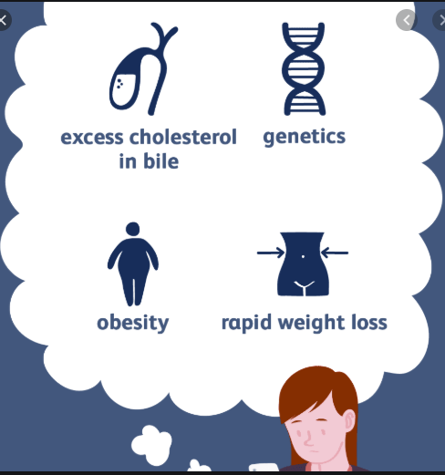
Risk factors and causes of Gallstones

Slide 6
Symptoms
Some of the signs and symptoms caused by gallstones include:
Fast spreading pain in the upper and center part of the abdomen exactly under the breastbone.
Intense pain between the shoulder blades especially on the right shoulder
Nausea and vomiting
Low tolerance to fatty food
Yellowing of the skin

Slide 7
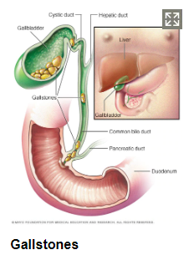
A picture of Gallstones

Slide 8
Morbidity and Mortality
Only few patients with gallstones become symptomatic. The mortality rate for an emergent cholecystectomy is 3%-5% with 30%-50% morbidity while the mortality rate for an elective cholecystectomy is 0.5% with less than 10% morbidity.
Gallstones may reappear in the bile duct following cholecystectomy. Distinctly, lone-incisional laparoscopic cholecystectomy seems to be connected to an incisional hernia rate of 8%, with age greater than or equal to 50 years and body mass index (BMI) of (≥30 kg/m2) as independent prognostic causes.

Slide 9
Examination
The common type of examination performed for people with cholethiasis is Ultrasonography (Tazuma et al., 2017).
It is the most precise, delicate, non-invasive and cheapest test for gallstones detection.
Additionally, it is easy, fast and safe in pregnancy since it does not bare the patient to detrimental radiation or circulatory contrast.
It has an advantage that it is performed specifically by the specialist at the bedside of the patient.
It is highly precise for gallstones larger than 2mm.

Slide 10
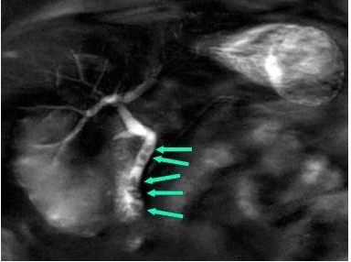
Ultrasound that shows Gallstones

Slide 11
Purpose of performing an Exam using an Imaging method
Imaging methods help in identification of those gallstones that are asymptomatic and helps in detecting the stage of the disease so that issuing of treatments become easy. Some types of imaging scans used include:
Abdominal ultrasound – It is a safe simple and accurate method of confirming the presence of gallstones. It uses sound waves to create images.
CT scan – It is a strong X-ray scan used to decide whether a person needs to undertake an operation.
MRI – Uses powerful magnetic waves to generate detailed images that help in assessing the gallbladder to discover any presence of cholecystitis.

Slide 12
Treatment Options
Gallstones can be treated through (Jeanty et al., 2015):
Cholecystectomy (Operation to remove the gallbladder). A medic may commend an operation to remove the gallbladder, as gallstones often reappear. Once the gallbladder is removed, bile flows straight from the liver into the ileum, rather than being kept in the gallbladder.
Prescriptions to melt the gallstones. Treatments may help dissolve gallstones but if stopped may lead to recurrence of the gallstones.

Slide 13
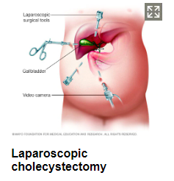
A picture that shows gallstones treatment

Slide 14
Causes
The causes of gallstones are not clear but they may occur when:
There is excessive cholesterol in the bile- if these cholesterols cannot be dissolved in the bile, they may harden up to form gallstones.
If there is excess bilirubin in the bile – Certain conditions such as biliary tract infections results in excessive bilirubin in the bile that may result to the formation of gallstones
Improper emptying of the gallbladder – This causes bile concentration that may lead to gallstone formation.

Slide 15
Body System Affected
Gallstones mostly affect the biliary system of the body which is responsible for the transportation of bile.
Gallstones are hard, stone-like masses that form in the gallbladder.
They occur as a result of the hardening in the biliary tract due to excess cholesterol and bilirubin. The two types include:
Cholesterol gallstones. The frequent occurring type of gallstone that appears yellowish in color due to high levels of cholesterol in the bile.
Pigment gallstones. This type results due to high levels of bilirubin in the bile. They appear to be dark brown or black in color.

Slide 16
Pathophysiology and Etiology of Cholelithiasis
The pathogenesis of cholecystitis is usually as a result of the blockage of the bladder on the neck, however, gallstones are not continuously present in cholecystitis (Tanaja et al., 2019).
Pressure on the gallbladder increases, making it enlarged as its walls thicken and the blood supply decreases, and a stone may form.
Cholecystitis may be chronic or acute, and recurrent incidents of acute swelling potentially leads to chronic cholecystitis.
The gallbladder can develop infections by numerous microbes, plus those that are gas forming. If the swelling is not treated a symptomatic sepsis may develop.
If cholecystitis is not properly treated, a damage of the gallbladder may occur which might result to death. Cholecystitis can also lead to the blockage of the pancreatic duct.

Slide 17
Sonographic findings
The sonographic characteristics of acute cholecystitis consist of the thickening of the walls of the gallbladder to about more than 5mm, development of pericholecystic fluid, gallbladder distention to over 5 cm, and a sonographic Murphy sign. The occurrence of several conditions escalates its diagnostic correctness.
Gallstones look like echogenic concentrations in the gallbladder. They move spontaneously with positional variations and cast an acoustic shadow.
The gallstones mostly appear to be yellowish in color with varying sizes of grains to golf ball.

Slide 18
Complications
Complications that may result because of gallstones include:
Swelling of the gallbladder. A gallstone that develops in the neckline of the gallbladder may lead to cholecystitis.
Obstruction of the common bile duct. Blockage of the ducts via which bile flows from the gallbladder may be occur leading to intense pains.
Blockage of the pancreatic duct. A gallstone can block pancreatic duct that may result to an pancreatitis
Gallbladder cancer. Individuals that have gallstones are at a high risk of getting gallbladder cancer, which is very rare.

Slide 19
Prevention
People can reduce their risks of getting gallstones if:
They take all the required meals in a day. People are advised to take every single meal in a day.
Lose weight gradually. People should lose weight at a slow pace i.e. about 1kg in a week, so that they reduce their chances of being at risks of developing gallstones.
Eat more fiber food. Fiber-rich food help in reducing constipation and thus prevent gallstones.
Maintaining a healthy weight. People should maintain healthy weights such that they are not obese and reduce their chances of getting gallstones.

Slide 20
Conclusion
Gallbladder ailments are mainly common auxiliary to cholelithiasis. While great cases of gallstones are asymptomatic, some cases can advance to a symptomatic illness.
Risk factors may include sex, customs, genetics, health history, and food. Gallstones are detected primarily through imaging methods.
These analytic procedures have their advantages and disadvantages, and their precision differs. The type of technique employed depends on the advancement of the disease. Asymptomatic patients usually do not need treatment.
Operation is the commonly used treatment, but other options are offered for patients who are not willing to undertake operation.

Slide 21
References
Jeanty, C., Derderian, S. C., Courtier, J., & Hirose, S. (2015). Clinical management of infantile cholelithiasis. Journal of pediatric surgery, 50(8), 1289-1292.
Pak, M., & Lindseth, G. (2016). Risk factors for cholelithiasis. Gastroenterology Nursing, 39(4), 297-309.
Tanaja, J., Lopez, R. A., & Meer, J. M. (2019). Cholelithiasis. In StatPearls [Internet]. StatPearls Publishing.
Tazuma, S., Unno, M., Igarashi, Y., Inui, K., Uchiyama, K., Kai, M., ... & Ryozawa, S. (2017). Evidence-based clinical practice guidelines for cholelithiasis 2016. Journal of gastroenterology, 52(3), 276-300.

